Slide 1
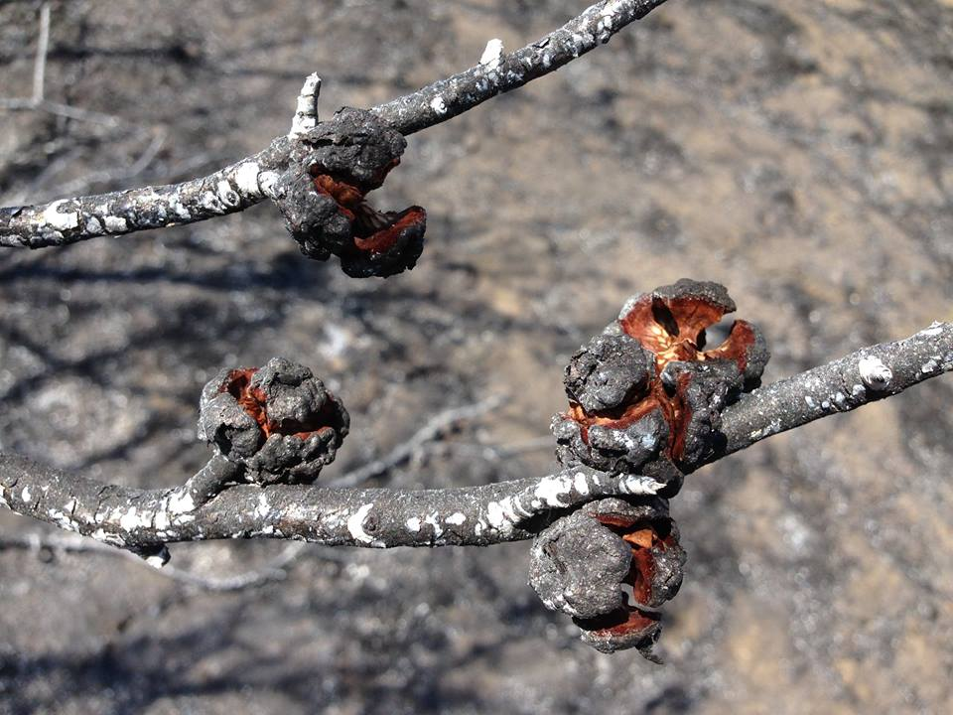
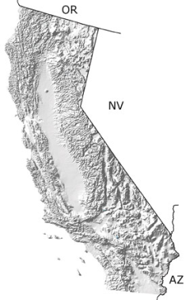
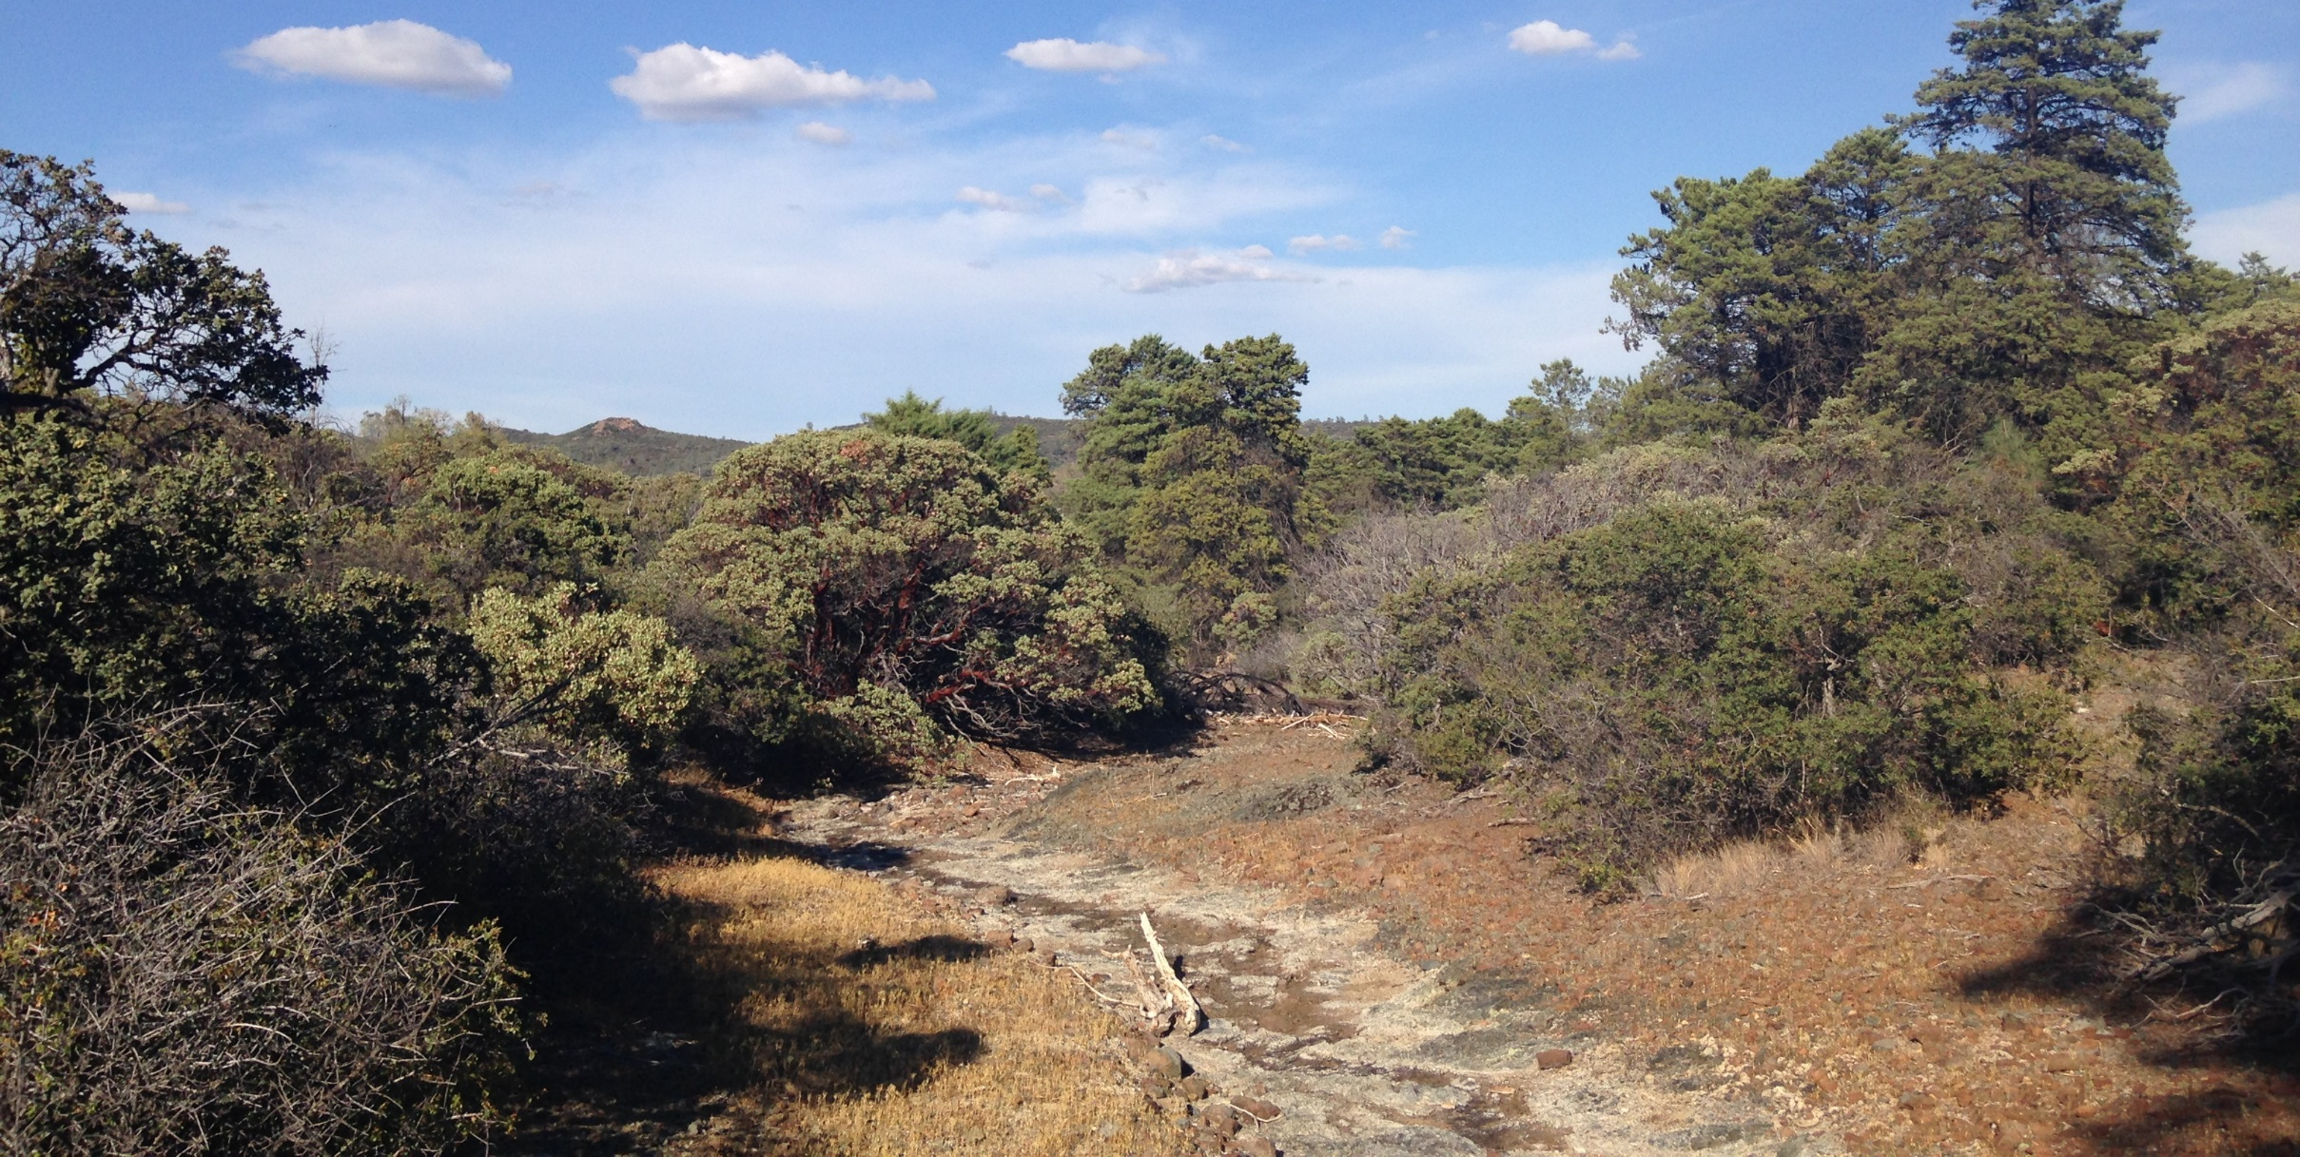
Seed Germination Requirements of Four Fire-Recruiter Chaparral Shrubs Kati McClain, Vivian Fung, and Rebecca E. Drenovsky Biology Department, John Carroll University
Introduction
Results
Background: Chaparral ecosystems
Biodiverse & globally distributed
Shrub-dominated
Wildfires coincide with hot, dry summers—important for renewal and regeneration
Resprouting (Fig. 1A)
Seed bank (Fig. 1B)
Challenges for seed bank recruiters:
Must receive proper cues to release from dormancy
Proper cues: fire or gut-related chemicals or heat (Fig. 1C)
Other factors also play a role in seed bank recruitment
Temperature cues
Maternal effects
Challenge following germination: emergence
Current research objectives: Determine the cues needed for seeds of key chaparral shrub species to break dormancy, germinate, and establish.
Hypothesis: I hypothesized that the cues required would differ based on species; seeds that are animal-dispersed would require acid scarification, and all seeds would require some type of cue related to fire (heat shock or chemical).
Ceanothus experiments:
Fall 2014:
C. cuneatus seed germination responded best to the boiling water treatment, but C. jepsonii seed germination was similar among treatments (Species* Treatment interaction, F=7.4, P=0.0008; Fig. 3).
Maternal effects weaker than treatment effects (Treatment*Maternal plant interaction, F=2.2, P=0.002), these effects were less strong than the species and treatment interaction.
Overall, emergence was low, but greatest for C. cuneatus in the boiling water treatment.
Summer & Fall 2015: Very low germination rates during summer. 2-4 week long cold stratification time was too short to break dormancy in the seeds. Germination rates highest with 3 months stratification (Fall) (data not shown).
Arctostaphylos experiment:
Fall 2014:
Treatment (F=4.9, P=0.007) and treatment and maternal plant (F=2.2, P=0.002) significantly affected seed germination.
Greatest germination was observed in the sulfuric acid treatment (Fig. 4) but emergence rates were very low.
Summer & Fall 2015: Results similar to those for Ceanothus (data not shown)
Fig. 1A: Resprouting after wildfire
Fig. 1B: Seeds released to seed bank after wildfire
Fig. 1C: Manzanita fruits following frugivory.
Discussion
Materials and Methods
Cues needed for Ceanothus:
Responded best to the heat shock delivered by the boiling water.
Chemical cues from charate were not necessary to induce germination
2-3 months stratification necessary to induce germination
Inconsistent with the majority of the literature
Typically, 2 to 4 weeks cold stratification sufficient for Ceanothus
Cues needed for Arctostaphylos:
Responded best to the concentrated sulfuric acid treatment, which mimics the mammal gut in the field.
Requires vigorous rinsing and pH check prior to plating
Likely, extreme acidity destroys the embryos
Charate not effective in stimulating germination—inconsistent with literature
2-3 months stratification necessary to induce germination
Inconsistent with the majority of the literature
Germination rates were generally very low for these species
Emergence:
Generating sufficient emergence was very challenging, especially for Arcotstaphylos. The roots appeared to be very brittle during transplantation, which may have contributed to the poor values.
Challenge: sufficient soil moisture without leading to fungal infection.
Many seeds developed fungal infections while on plates
Perhaps require pre-treatment bleaching
Future Studies:
Now that germination cues are better understood, we are looking to improve emergence rates.
Direct sowing in soil, post-treatment, to minimize fungal and transplantation issues
Reconsider charate and effects of chemical cues on the Arctostaphylos species, in addition to these subsequent change.
ACKNOWLEDGEMENTS: I would like to thank the Barrett Undergraduate Endowment Research Award and John Carroll University Biology Department for funding this project. Thank you to the Honors Program for the opportunity to present my research.
Study Site and Species Selection: The seed for this study was collected on 18 July 2012 from the University of California McLaughlin Reserve, located near Lower Lake, California (Fig. 2A-B). Four species (two congener pairs) were chosen for study. Congener pairs differ in their adaptation to serpentine soils.
Arctostaphylos manzanita and A. viscida: members of this genus need a chemical cue to break dormancy.
Ceanothus cuneatus and C. jepsonii: members of this genus need heat shock from wildfires to break dormancy.
Ceanothus experiments:
Fall 2014: Ceanothus seeds from 6 maternal plants received one of four different treatments: control, charate (ground & burned chaparral wood), boiling water, and boiling water and charate and were placed on moistened filter paper in petri dishes. Following three months cold stratification, germination was monitored for 1 month in the greenhouse.
Summer & Fall 2015: C. jepsonii seed received one of four treatments: control, boiling water, hot water, and hot sand. Stratification periods were varied from 2 weeks to 3 months; germination protocols were followed as previously described.
Arctostaphylos experiments:
Fall 2014: Arctostaphylos seeds from 11 maternal plants received one of four treatments: control, charate, concentrated sulfuric acid, and concentrated sulfuric acid and charate. Stratification & germination protocols were followed as previously described.
Summer & Fall 2015: Arctostaphylos seed received one of nine different treatments manipulating sulfuric acid concentration (70%, 90%, concentrated) and time of exposure (1, 3, or 6 hours). Stratification periods were varied from 2 weeks to 3 months; germination protocols were followed as previously described.
Fig. 2A: Location of University of California McLaughlin Reserve, CA
Fig. 2B: Serpentine seep, UC McLaughlin Reserve
Fig. 3: Percent germination for Ceanothus species from Fall 2014. Each bar represents data from one maternal plant*treatment combination, which were run in triplicate. Missing bars indicate that no seed from the maternal plant germinated in that treatment. Data are means + SD.
Fig. 4: Percent germination for Arctostaphylos species from Fall 2014. Each bar represents data from one maternal plant*treatment combination, which were run in triplicate. Missing bars indicate that no seed from the maternal plant germinated in that treatment. Data are means + SD. Note difference in scale from Fig. 3.

