Slide 1
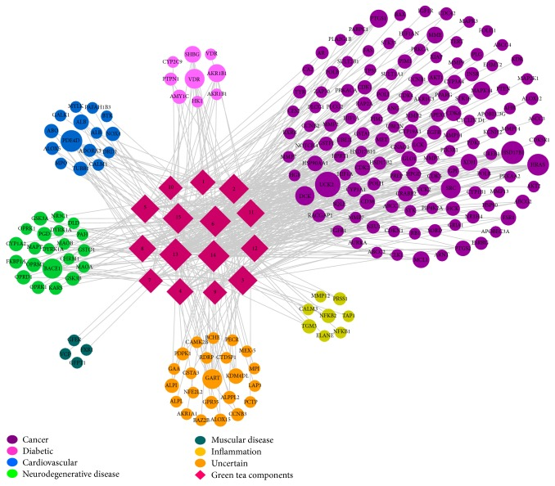
Is Green Tea the Panacea We’ve Been Searching For? A Review of the Scientific Literature on Green Tea in Health Eleanor L. Axson, Undergraduate Honors; Adviser: Dr. James Lissemore, Department of Biology
Abstract
Green tea is claimed by news media and scientists alike to be a source of health benefits for many conditions in humans. However, with the supposed health benefits of green tea ranging from ultraviolet light protection to memory improvement to weight management, it can be difficult to separate fact from fiction. Because tea is the most consumed beverage in the world, aside from water, even small beneficial health effects in humans could result in significant effects in global public health. I conducted a critical review of the research literature on green tea and human health and analyzed the validity of these claims. While epidemiological studies look promising, clinical and laboratory trials to date are not compelling, requiring large doses and producing poorly defined benefits.
r = 0.73 (with outliers, in black)
r = 0.60 (without outliers)
Would require at least
180 cups of green tea
to achieve 6 μM in plasma
Lab Studies: see min. results between 10 μM and 50 μM EGCG
Cao et al. 2013;
Kim et al. 2013
15 Polyphenols, 200 Targets
The Ohsaki Study
Five or more cups of green tea daily reduced risk of death from all causes
Kuriyama et al. 2006
Pan-Assay Interference
Capable of "tricking” assays into giving false-positive results with no drug effects
Baell and Walters 2014
EGCG May Act Randomly by altering membrane protein function and thus appear pervasively active
Ingólfsson et al. 2014
Potential Liver Damage
Typically 400 mg EGCG doses for over one month
Emoto et al. 2014
Cardiovascular Disease
Five or more cups of green tea daily reduced risk of development by 31% in women
Conclusions
Strong epidemiological data supports the idea that green tea provides beneficial health effects in many health conditions, but only modest results in NIH-funded clinical trials.
Bioavailability of EGCG, green tea’s main polyphenol, is poorly understood.
There is inconsistent EGCG concentrations within the same amount of green tea.
Laboratory studies use large doses of EGCG not possible from drinking green tea alone.
Large doses of EGCG have been implicated in causing liver damage.
The non-specific nature of green tea polyphenols leads to questions of pan-assay interference.
In the absence of convincing mechanisms and consistent dosing, it is difficult to see green tea, or any of its components, rising to pharmaceutical status.
Kuriyama et al. 2006
EGCG in Green Tea
In 100 g, there is 100 fold variation in [EGCG]
Zhang et al. 2014
USDA
2013
Bone Mineral Density
EGCG & Tai Chi maintained bone mineral density in postmenopausal women
Shen et al. 2012
HPV Infection
No evidence that EGCG cleared HPV infections
Garcia et al. 2014
Leukemia
EGCG treatment, may stop advance, 70% of pts.
Shanafelt et al. 2013

