Slide 1
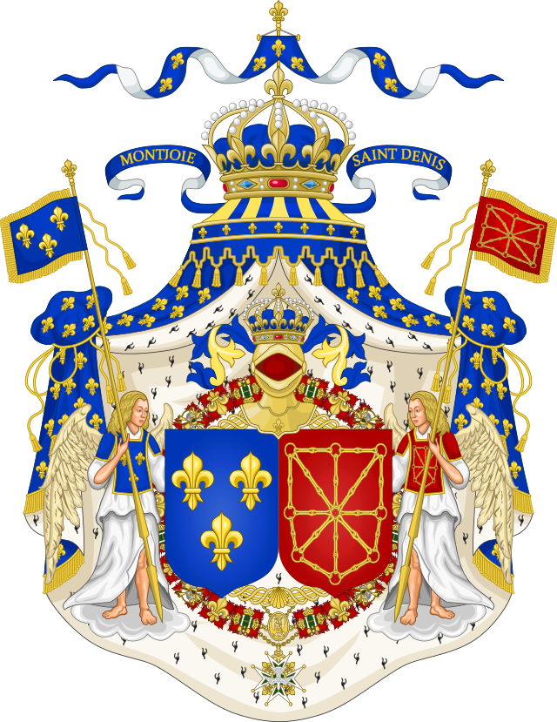
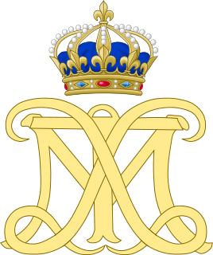
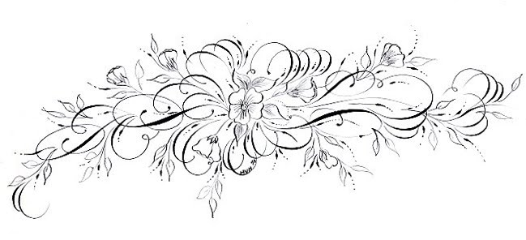
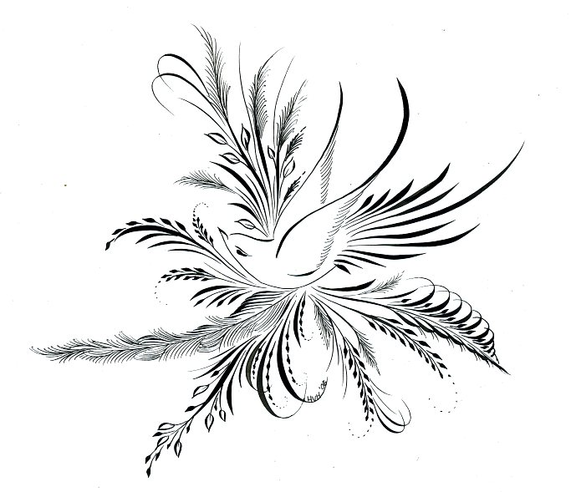
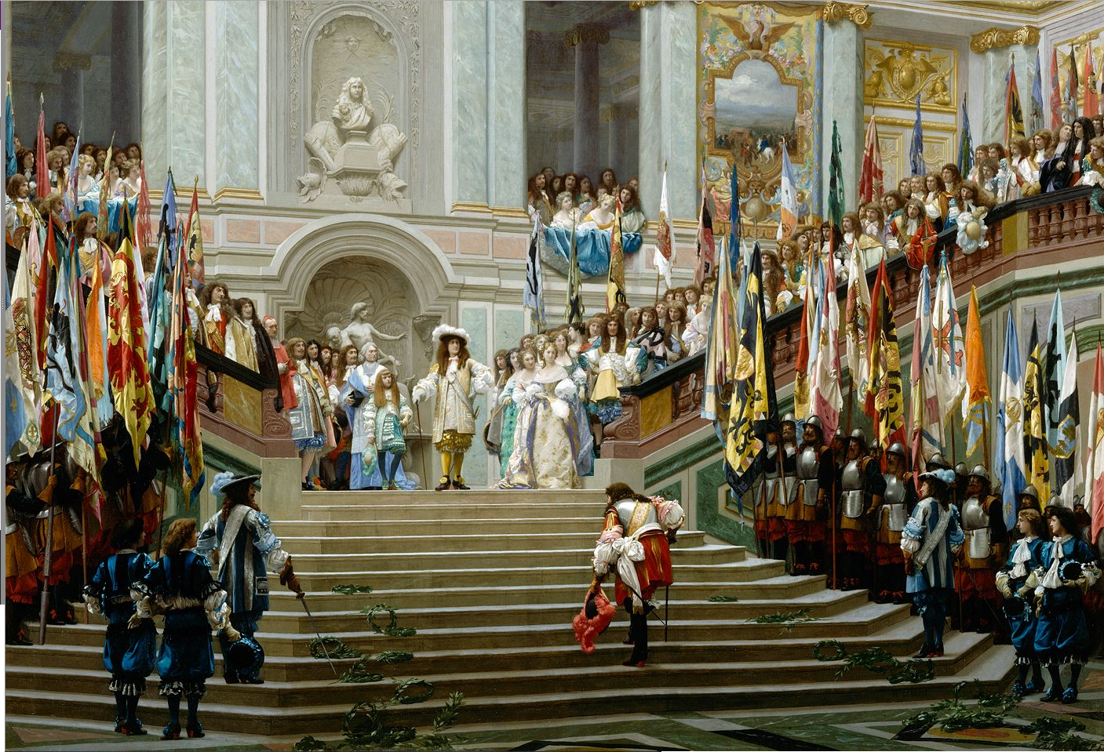
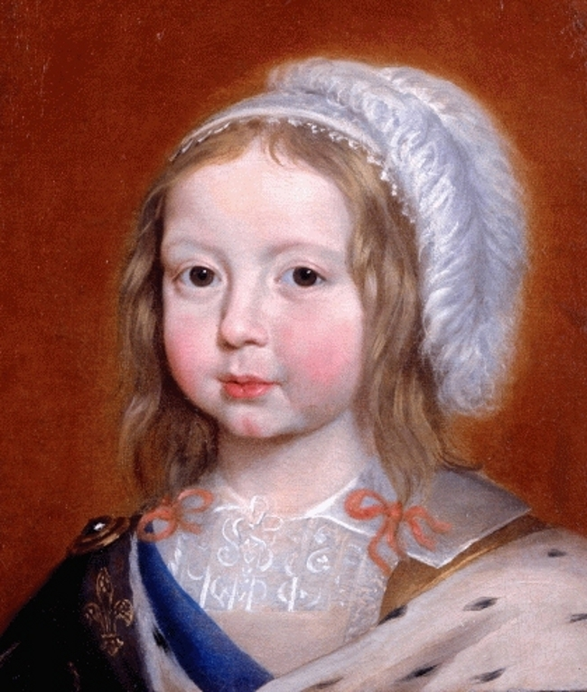
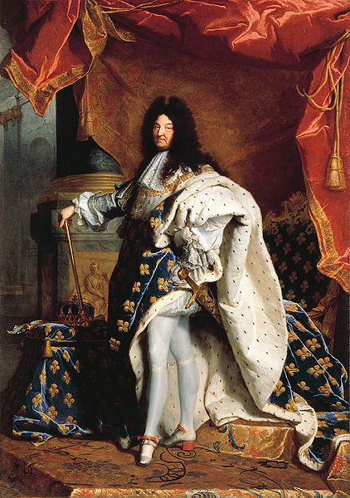
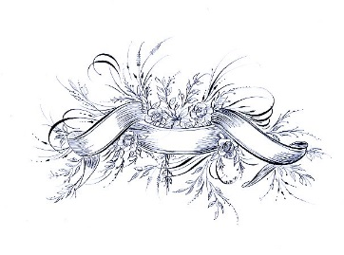
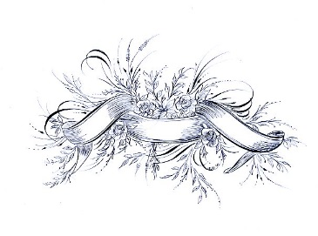
Louis XIV, King of France and Navarre; Do Clothes Really Make the Man? By Arnold Paskay; Supervised By Malia McAndrew Ph.D., John Carroll University
Background
Louis XIV (1638-1715), often referred to as “The Sun King”, whose family, the Bourbons, were embroiled to the tumult of France and her politics. Louis XIV’s grandfather, Henri IV (1553-1610), was assassinated in Paris. His father, Louis XIII (1601-1643), was guided throughout most of his reign by the crafty and intelligent Cardinal Richelieu (1585-1642).
Upon the death of Louis XIII, the future king was 5. His mother Anne of Austria was made Regent. She was guided by Cardinal Mazarin (1602-1661), a protégé of Cardinal Richelieu.
During the Regency, Louis XIV’s uncle, King Charles I of England, was executed. His wife and son, the future Charles II, fled to France. Their arrival, coupled with French Aristocrats who were hungry for more power launched a reign of terror called Le Fronde which nearly toppled the monarchy.
Politics
A parlement is a legislative body in charge of a city which resulted from the localized politics of Medieval France. Their power in the early 17th century basically consisted approving what the King wished to pass. They could not refuse, but they could stall for immense lengths of time.
Louis XIV changed this by making any debate of his laws illegal in 1667, after charming many a magistrate. He also dismisses his chief minister and reconfigures all his advisory councils.
As a result, there was no way for the parlements to affect Louis XIV’s reign in any way.
__________________________________________
Before Louis XIV, the Aristocracy of France still had quite a bit of autonomy, making an uprising like le Fronde possible.
In order to keep the Aristocracy out of politics, Louis XIV insisted that all nobility attend him at court, making it impossible for them to plot anything against his will except at Versailles.
Culture
Versailles was the center of court life for most of Louis XIV’s reign. Everything from the columns to the silver pots in the Orangerie were meant to display Louis XIV’s power as King and enforce his Divine right to rule France.
The etiquette and protocol consisted of a series of ceremonies from waking to retiring designed by Louis XIV to express his dominance over all who surrounded him.
Conclusion
Louis XIV was traumatized by events in family history and Le Fronde. As a result, he was determined to quell any usurpers in France. Said goal was attained by halting political debate and keeping the aristocrats right under his nose through etiquette and protocol.
The impact of Louis XIV’s will be felt on politics and French culture almost unchanged until 1789. Some aspects exist until this day.
References
Réception du Grand Condé à Versailles, Jean-Léone Gérôme, 1877
Louis-Dieudonné, Dauphin of France, Claude Deruet, 1643
Louis XIV, Hyacinthe Rigaud, 1701
Beik, William. Louis XIV and Absolutism: A Brief Study with Documents. Boston: Bedford / St. Martin's, 2000.
Christian Milet, Present-day view of the King's bedchamber in his Grand Apartment. 2009, Digital photograph, 2000 x 1339 pixels. The Palace of Versailles.
Doyle, William. The Ancien Regime / William Doyle. n.p.: New York: Palgrave, 2001.
Duc de Saint-Simon, Louis de Rouvroy. Memoirs of Louis XIV. Vol. 3. Washington DC: Walter Dunne, 1901.
Frasier, Antonia. Love and Louis XIV. New York City: Doubleday, 2006.
Green, Frederick Charles. The Ancien Regime: a Manual of French Institutions and Social Classes. n.p.: Edinburgh: University Press, 1960.
Gundle, Stephen. Glamour: a History / Stephen Gundle. n.p.: Oxford; New York: Oxford University Press, 2008.
Le Roy Ladurie, Emmanuel. The Ancien Régime: a History of France, 1610-1774 / Emmanuel Le Roy Ladurie; translated by Mark Greengrass. n.p.: Oxford; Cambridge, Mass.: Blackwell, 1996.
Hurt, John J. Louis XIV and the Parlements: The Assertion of Royal Authority. Manchester: Manchester University Press, 2002.
Hyacinthe Rigaud, Louis XIV. 1701, Oil on canvas. Louvre Museum.
Mansel, Philip. Dressed to Rule: Royal and Court Costume from Louis XIV to Elizabeth II. New Haven: Yale University Press, 2005.
Mermier, Guy C. France: Past & Present. New York City: Peter Lang, 2000.
Rabinovitch, Oded. "Versailles as a Family Enterprise: The Perraults, 1660-1700." French Historical Studies 36, no. 3 (2013): 385-416.
Sturdy, David J. Fractured Europe 1600-1721. Oxford: Blackwell Publishers Ltd., 2002.
Tocqueville, Alexis de, and John Bonner. The Ancien Regime / Alexis de Tocqueville; translated by John Bonner; introduction by Norman Hampson. n.p.: London: Dent, 1988.
Treasure, Geoffrey. Louis XIV. Harlow, England: Pearson Education, 2001.
Wilson, Peter H., ed. A Companion to Eighteenth-Century Europe. Oxford: Blackwell Publishers Ltd., 2008.

